Slide 1


SEZs and AfCFTA Regulations and Rules of Origin
Dr. Nicholas Charalambides,
Director, Imani Development

Slide 2






Overview
1
SEZs and the realisation of the AfCFTA
2
Application of FTA rules to SEZs
3
Concerns of unfair competition
4
Rules of Origin for SEZ produced products in FTAs
5
AfCFTA Rules of Origin for SEZs
6
The right way to deal with concerns?

Slide 3
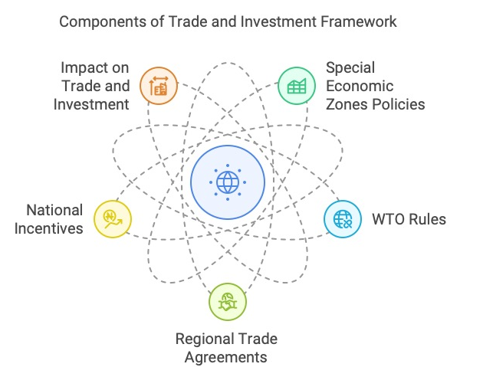
SEZs and trade agreements

Slide 4
SEZs and the realisation of the AfCFTA
The recent wave of African regionalism can aid the regional integration and specialization of African SEZs.
Introduction of the AfCFTA can, in theory, unlock a wide range of opportunities for SEZs, including greater market access, lower-cost and higher-quality production inputs, and the opportunity to benefit from emerging regional value chains.
…Moreover, whether SEZs benefit from greater trade and economic integration across Africa will largely depend on outstanding issues, such as the handling of rules of origin and how SEZs are treated in the AfCFTA’s SEZ-relevant provisions.
Generally, the creation of a level playing field – for instance, in terms of fiscal incentives offered by SEZ programmes and behind-the-border trade barriers – will help African SEZ-based firms to improve their competitiveness on the global stage and mitigate the risks involved with the pursuit of zone-based development strategies in the context of regional integration.
(Handbook on Special Economic Zones in Africa)

Slide 5
How FTAs work to create preferential market access
The basic requirements for implementing a FTA are a tariff phase-down schedule and rules of origin.
The tariff schedules set out the preferential market access treatment in terms of reduced tariffs
There are two kinds of origin: non-preferential and preferential
Non-preferential origin confers an "economic" nationality on goods; it does not confer a tariff benefit on them, but is the basis for the implementation of other trade policy measures.
Preferential origin is conferred on goods from particular countries when they fulfil certain criteria.
In some cases, it is straightforward to “nationality”. E.g. wheat is ”wholly produced” in a particular country.
But what about a T shirt using Imported fabric?
How to know which T Shirts made in an FTA should qualify for tariff preferences and which should not. What rules to use? Value Addition, CTH? If Value Addition, how much?
Preferential rules of origin set out the requirements for a good to be considered as made within the FTA and therefore eligible for preferential market access.
(The Treatment of Goods Originating in Special Economic Arrangements/Zones in the African Continental Free Trade Area. 2018)
(Guide to the Protocol on rules of origin of the Economic Partnership Agreement (EPA) between the European Union and its Member States, of the one part, and the SADC1 EPA States, of the other part)

Slide 6
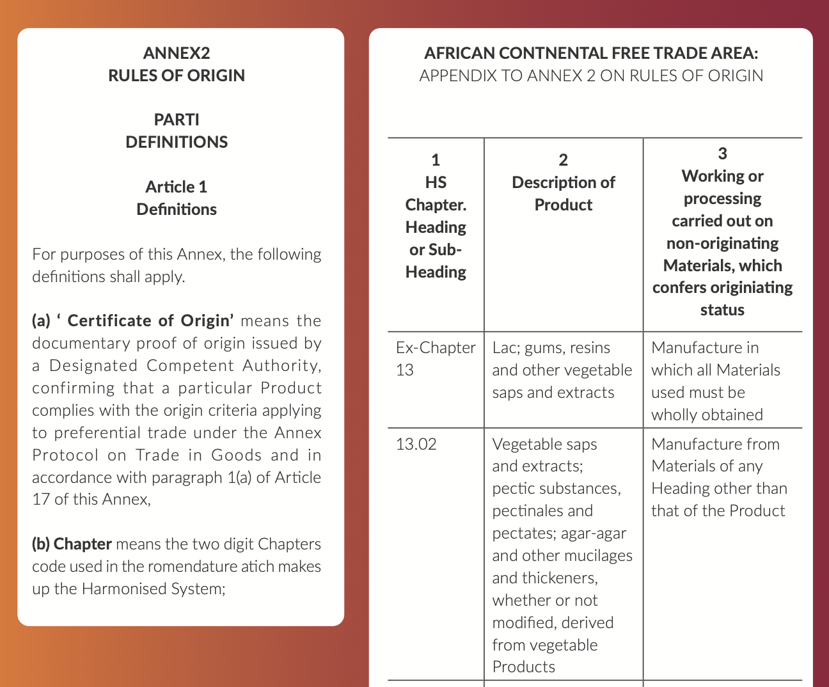
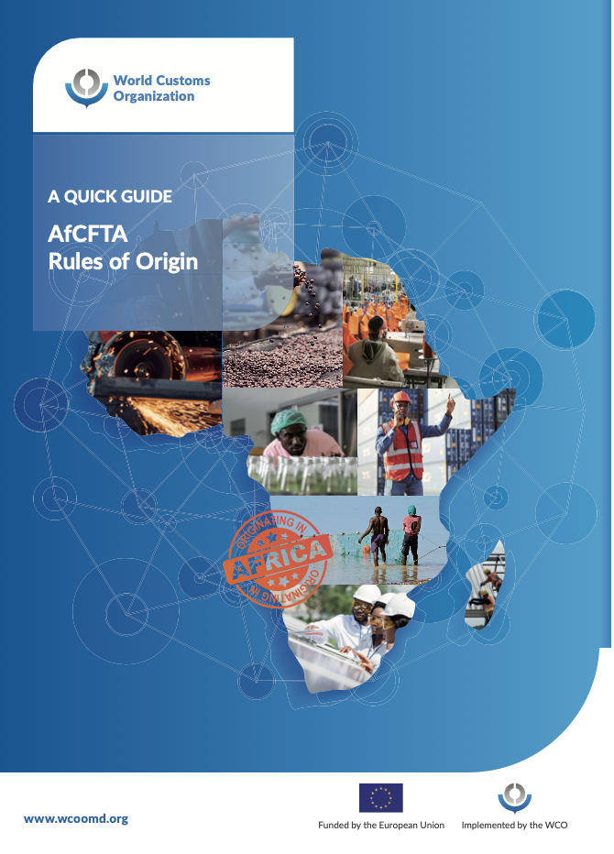
Rules of origin in the AfCFTA

Slide 7
Application of FTA rules to SEZs
The great majority of regular RTA provisions apply to SEZs in the same manner as apply to the remainder of a party’s territory.
Sometimes, however, RTAs include rules that explicitly refer to SEZs.
Such rules include definitions, reaffirmations of treaty obligations, exceptions or reservations from obligations, provisions on institutional cooperation, or rules setting out specific SEZ-focused content.
Some rules specific to SEZs set out how products originating from partners countries’ SEZs should be treated upon importation. Others modify general rules of origin for products originating from SEZs (by making them more stringent,
In some RTAs, the rules of origin prohibit the use of duty-drawback systems for certain materials (e.g. those imported in the SEZ country and used in the production)
WIR Chapter IV Special Economic Zones )

Slide 8
Concerns over unfair competition
The concern of some African countries is how to address unfair competition that may emanate from goods produced in SEZs and trade under AfCFTA preferential treatment.
The rationale is that, as goods produced in SEZs benefit from tax and other investment incentives, the cost of manufacture will be lowered so goods produced in SEZs will be able to be sold for less than goods not manufactured in SEZs.
The Treatment of Goods Originating in Special Economic Arrangements _ Zones in the African Continental Free Trade Area)

Slide 9
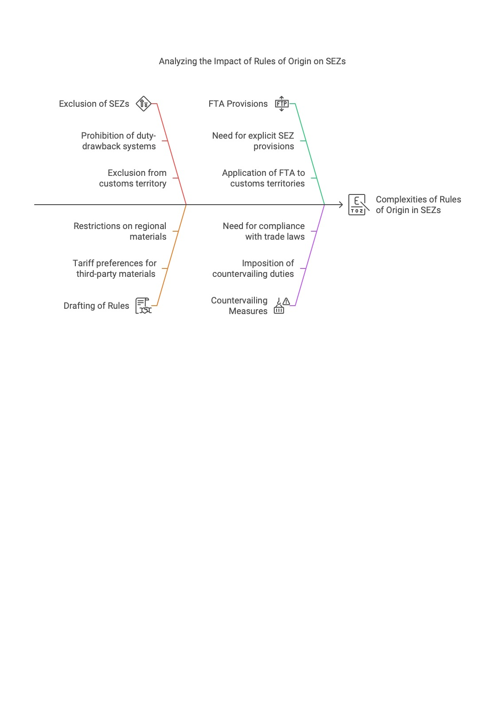
Rules of origin for SEZ produced products in African FTAs
Why the rules of origin?
Can be used to exclude goods produced in an SEZ.
In some RTAs, the rules of origin prohibit the use of duty-drawback systems for certain materials (e.g. those imported in the SEZ country and used in the production)
Rules of origin can preclude the “need” for SEZ exclusion or restriction depending on how they are drafted. For example, allowing clothing made of third party fabric to benefit from tariff preferences is a very different proposition to restricting preferential treatment for clothes made from fabric produced within the region
Practical aspects
Provision is often needed in an FTA to explicitly address SEZs and rules of origin because a country may exclude SEZs from their customs territory. And FTAs generally apply to Customs Territories
Needed to impose countervailing measures
(Special Economic Zones in an Era of Multilateralism Decadence and Struggles for Post-Pandemic Economic Recovery: Perspectives from the Global South, CUP 2023)

Slide 10
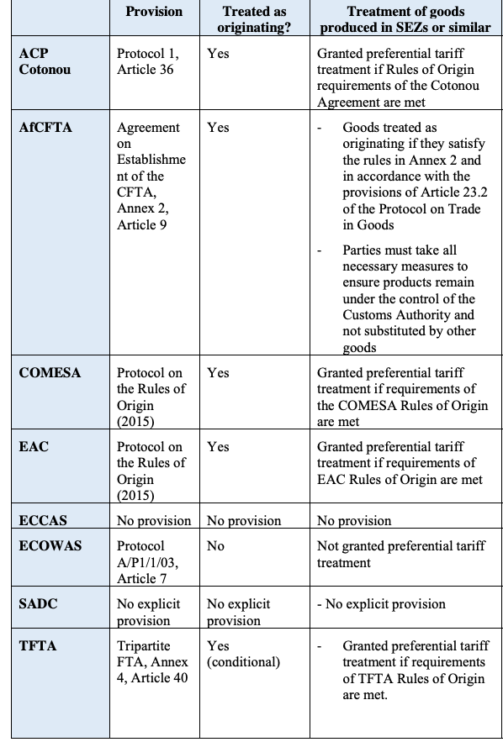
Treatment in African FTAs
Most African RECs with the exception of ECOWAS do not apply restrictions on preferential treatment to product originating in SEZ.
(The Treatment of Goods Originating in Special Economic Arrangements/Zones in the African Continental Free Trade Area. 2018)

Slide 11
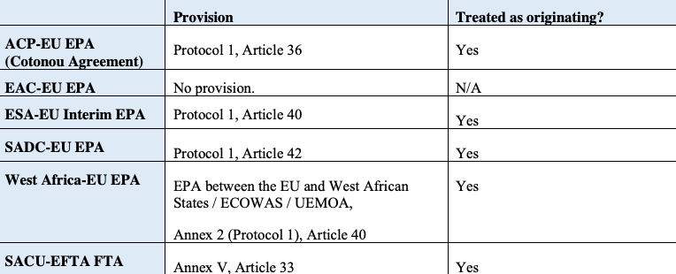
Treatment in FTAs Africa and the Global North
EPAs with African RECs and AGOA do not apply any restrictions on preferential tariff treatment

Slide 12
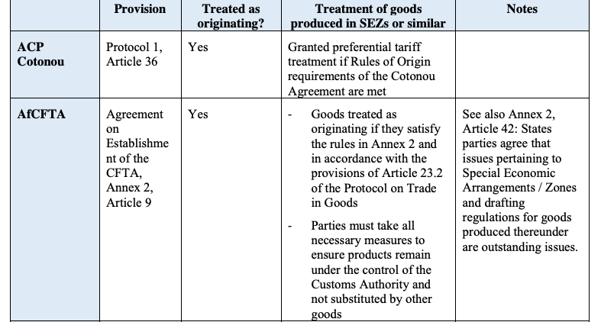
AfCFTA Rules of Origin for SEZs
The 11th Council of Ministers of Trade held in Gaborone, Botswana, from 11-12 February 2023 agreed on the Ministerial Regulation on SEZs to open the African market for goods made in SEZs in Africa to be traded preferentially as long as they meet the agreed Rules of Origin. (Addresses Annex 2, Article 42)
To address the concerns raised by Tanzania and Senegal in respect of unfair competition, the 11th Council of Minister agreed on the following additional provision:
“In order to safeguard the domestic market from unfair competition, provisions under the Annex on Trade Remedies, the Competition Policy Protocol, and the Infant Industries Protection provision shall be applicable to the Goods from the special economic zones. Any state party shall have the right to regulate Special Economic Zones (SEZs) in accordance with their domestic laws.”
(National Centres Briefing on the African Continental Free Trade Area (AfCFTA),

Slide 13
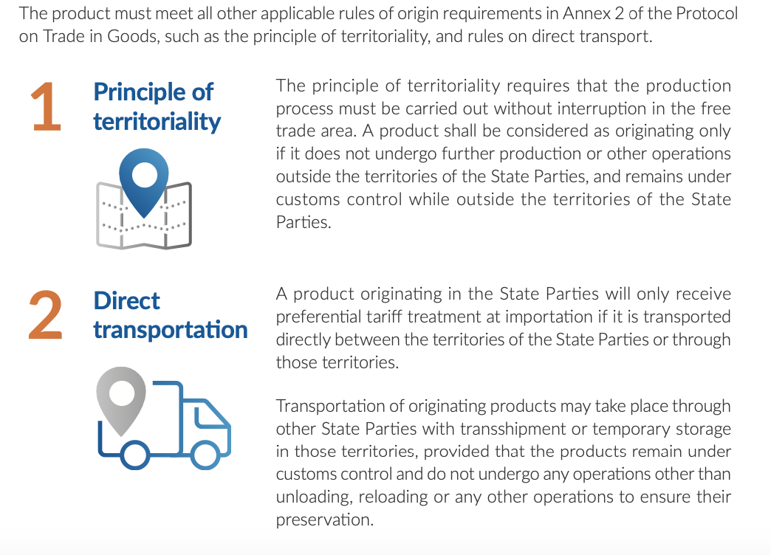
There are practical implications for SEZs
A Quick Guide: AfCFTA Rules of Origin, WCO

Slide 14
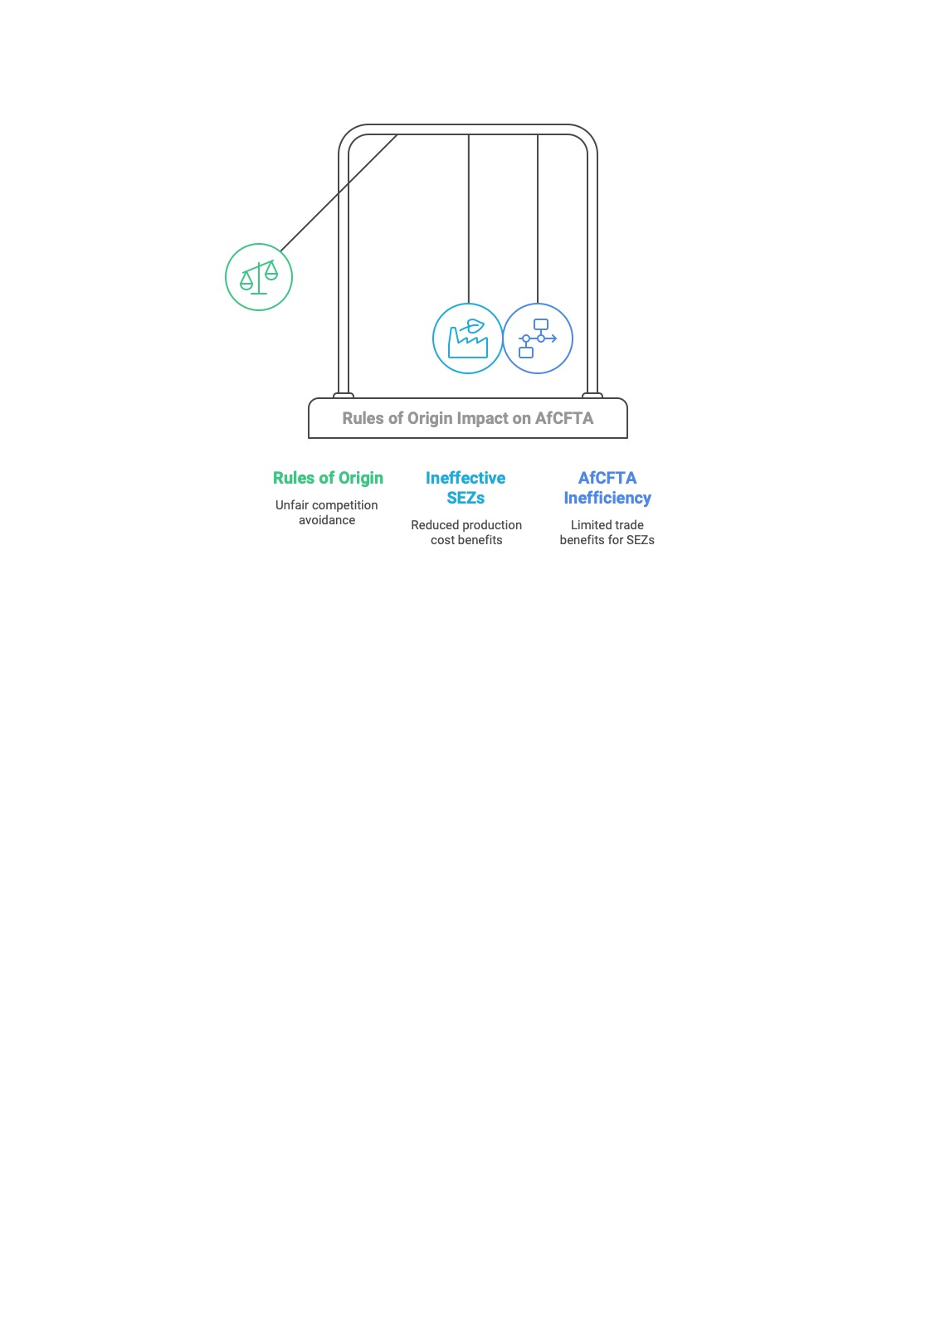
The right way to deal with unfair competition?
“Using rules of origin as a means to avoid unfair competition, a use that rules of origin are not designed for, will be ineffective and counterproductive.
SEZs have evolved from firms in an enclave and many countries offer tax and investment incentives to companies / firms not in a specific enclave;
The tax incentives provided to firms in SEZs may not allow them to reduce costs of production; and
Excluding goods produced in SEZs will reduce the effectiveness and efficiency of the AfCFTA.
A level playing field? If excluded by rules of origin restrictions. the same product manufactured in an SEZ in AfCFTA can be exported to EU and US with preferential tariff treatment while it will not be entitled to AfCFTA tariff treatment
The Treatment of Goods Originating in Special Economic Arrangements _ Zones in the African Continental Free Trade Area)
“Instead AfCFTA State Parties should make use of WTO rules on subsidies and countervailing measure as referred to in Article 2 of Annex 9 to the AfCFTA Protocol on Trade in Goods.”
The Treatment of Goods Originating in Special Economic Arrangements/Zones in the African Continental Free Trade Area. 2018)

Slide 15
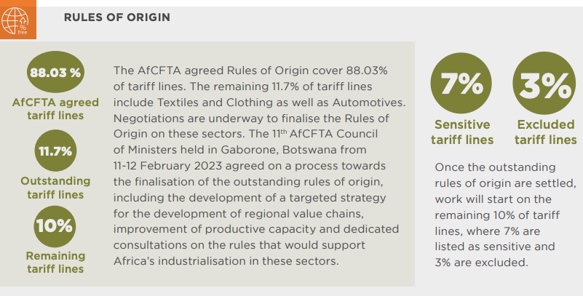
Final reflections
But Capacity in Trade Remedies is weak
And some sensitive sectors are yet to be finalised
United States Mexico and Canada Agreement includes RoO provisions relating to labour standards. Trade Union Movement is interested, but difficult to implement. For another day!

